Slide 1

Research Report
Antonin Perrot-Audet
5GE INSA Lyon,
TDSI, master GEGP SI

Slide 2
Outline
Context
State of the art
Proposal
Results/Evaluation
Conclusion

Slide 3
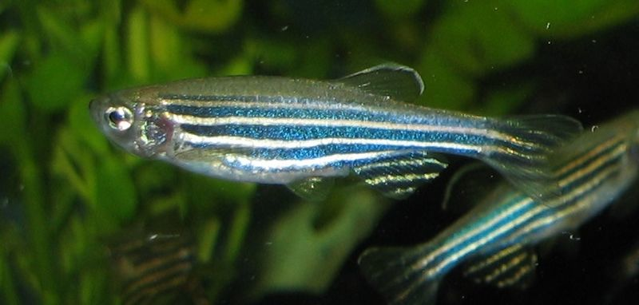
Context
The Megason lab studies the development of zebra fishes.
Ajouter development
3cm

Slide 4
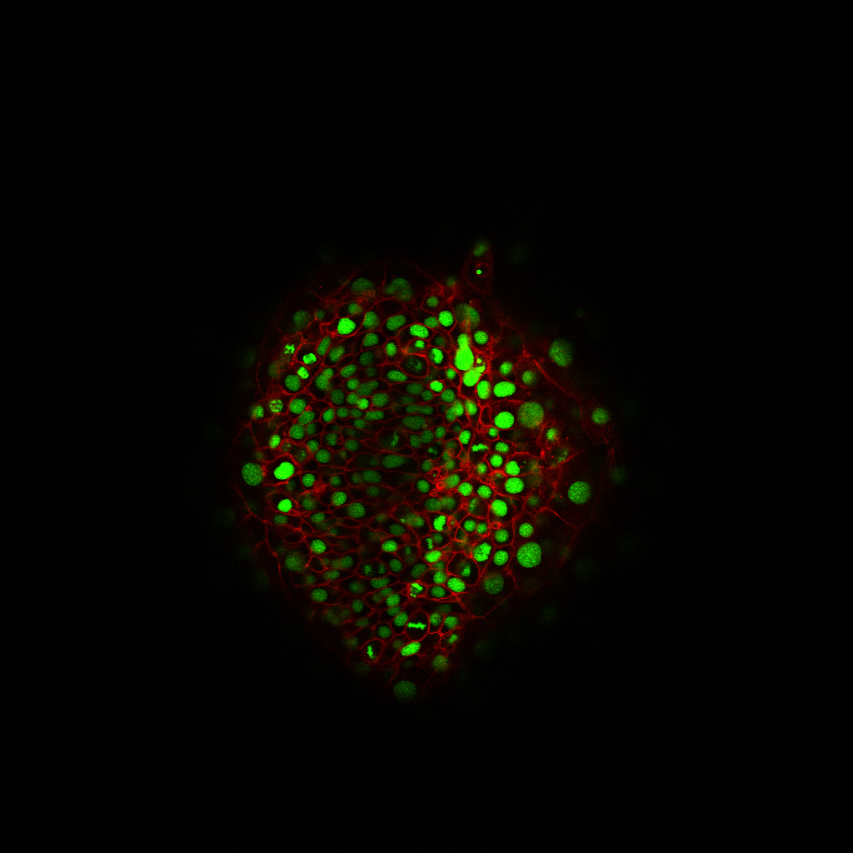
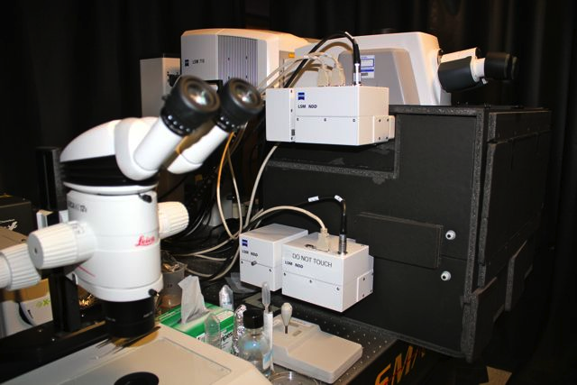
Context
Through confocal microscopy

Slide 5
Context
Biology through observation
Long term goal :
Understand the development process.
Create a numeric model of an entire zebrafish.
Apply genetic discoveries to human…
Need to detect and segment each cell and the membrane.

Slide 6
Problematic
Problematic:
Membrane segmentation :
Need a lot of a priori :
Closed structure around each nuclei.
Detection of cell nuclei provides capital information for segmenting the membrane :
Detection of cell nuclei :
Initialization of a topology constrained algorithm

Slide 7
State of the art : Data
Huge datasets :
1024x1024x70x700x2
Hard to process :
Noisy
Anisotropic
Artifacts (interlacing, membrane closure missing…)

Slide 8
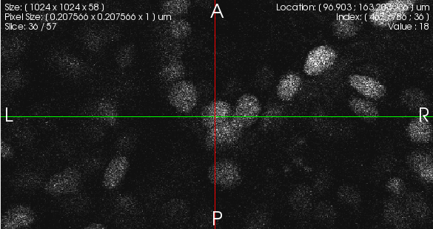
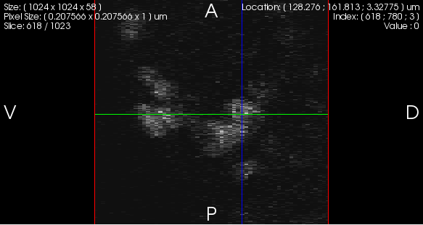
State of the art : Data

Slide 9
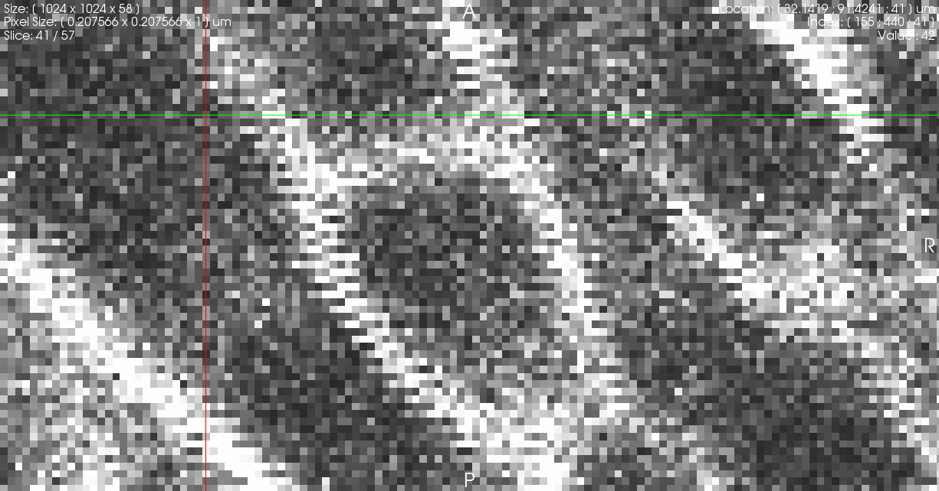
State of the art : Data

Slide 10
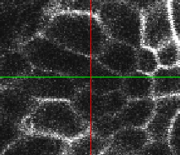
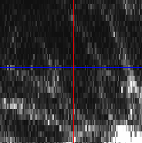
State of the art : Data

Slide 11
State of the art : Existing algorithms
In the bibliography:
Gradient based
Different data (2D, different imaging techniques)
In the Megason lab:
Combination of several information (radial voting map[1] , Hough transform voting map, distance map)
Performances need to be improved.
[1] H. Chang, Q. Yang, and B. Parvin. Segmentation of heterogeneous blob objects through voting and level set formulation. Pattern recognition letters, 28(13):1781–1787, 2007.

Slide 12
Proposal
Observations:
Most algorithms make use of the nuclei channel
The membrane channel also provides information about the nuclei position.
Hypothesis:
Cell membrane is closed; one closed cell contains one nuclei.
The membrane channel can be represented by a Voronoi diagram centered in each cell.

Slide 13
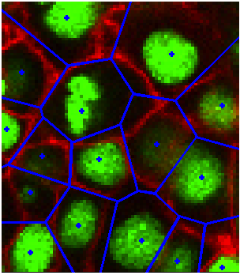
Proposal
Sites
Regions
Boundaries

Slide 14
Proposal
Method :
From the membrane channel : detect the Voronoi sites corresponding to cell nuclei.
From the Voronoi region, locate the nuclei.
Idea :
Use the distance map information to approximate the Voronoi region.
Find the centroid of the Voronoi regions.

Slide 15
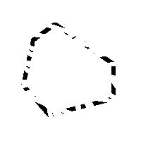
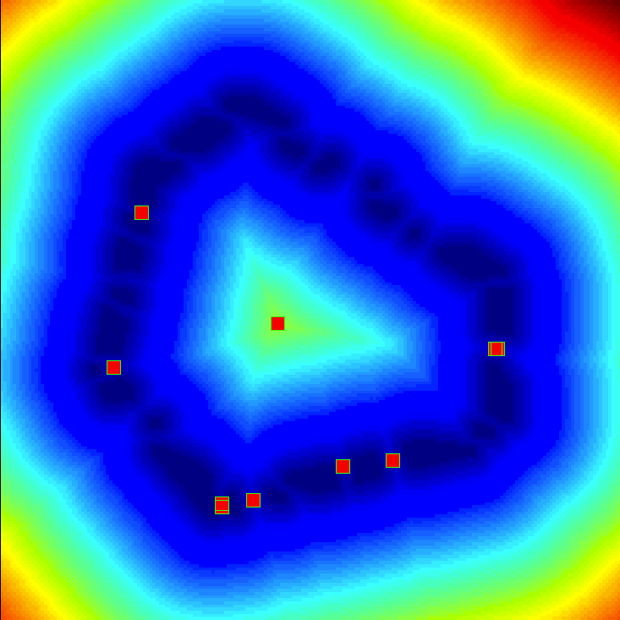
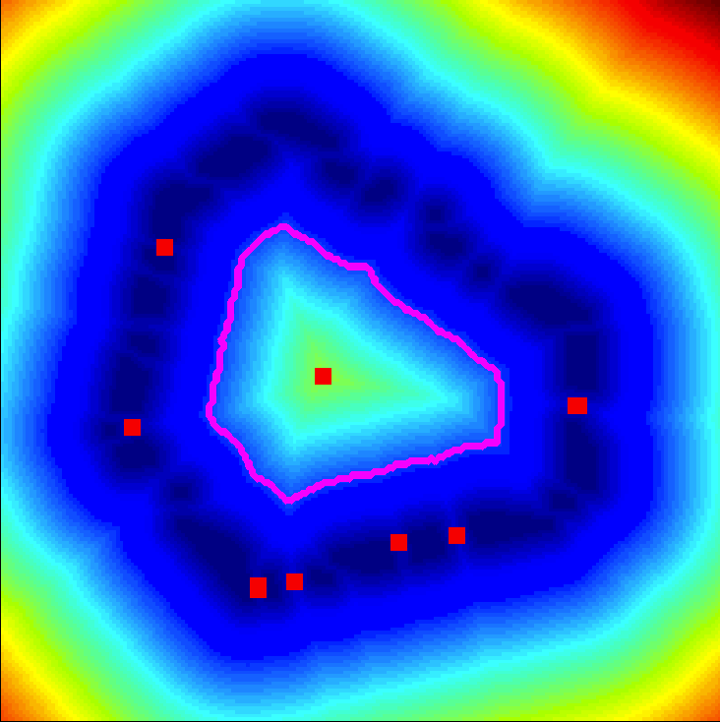
Proposal
Detection of approximate Voroni regions : threshold on the distance map.

Slide 16
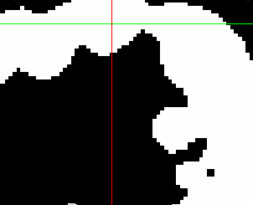
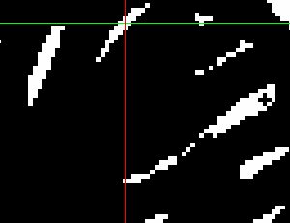
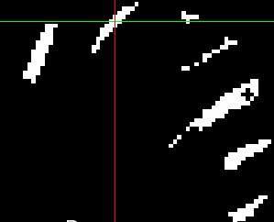
Proposal
Use of the nuclei channel :
Adjust the localization of centroids :
Use this information to mask the approximate Voronoi regions, and center the regions on the nuclei.

Slide 17
Proposal
Resume :
Membrane information : for finding Voronoi regions in which one nuclei is present.
Nuclei information : for centering the estimation of the nuclei position.

Slide 18
Evaluation
Evaluation/Comparison of several algorithms:
Scale constrained multsicale Laplacian of Gaussian [2] (MLOG)
Existing algorithm in the Megason lab (KA)
Our proposal (P)
“Success” measure :
[2] Y. Al-Kofahi, W. Lassoued, W. Lee, and B. Roysam. Improved Automatic Detection & Segmentation of Cell Nuclei in Histopathology Images. IEEE transactions on bio-medical engineering, 2009.

Slide 19
Evaluation
Evaluation datasets :
Synthetic:
10 datasets containing 100 to 1000 points.
Simulates :
Noise,
Point spread function & anisotropy.
Does not include:
Intensity inhomogeneity & lack of information,
Overlapping nuclei.
Real:
Already presented dataset: a region containing 141 nuclei was manually segmented.

Slide 20
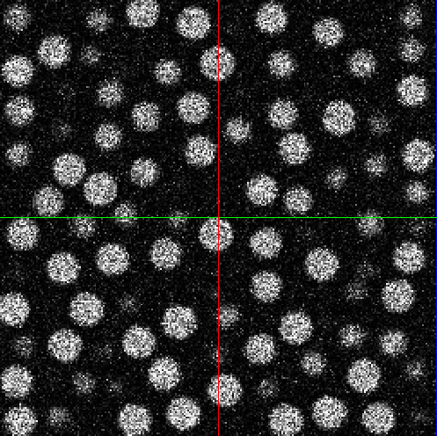
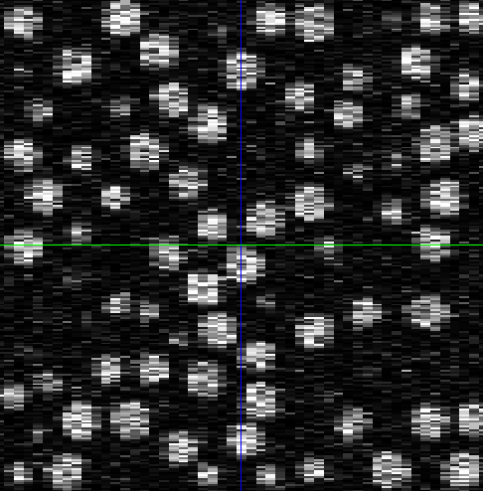
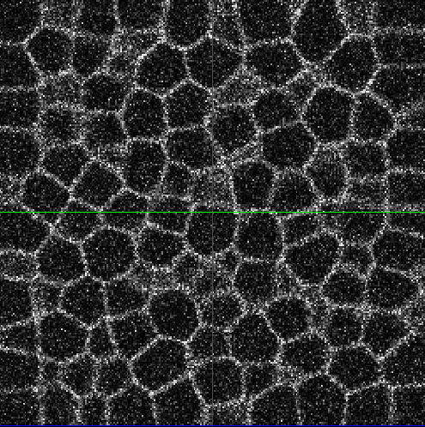
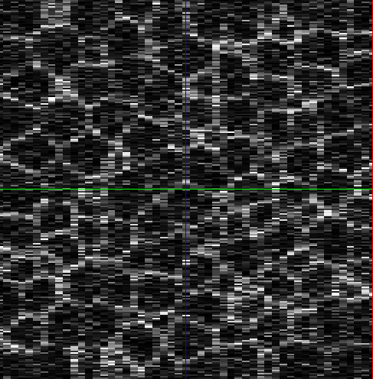
Evaluation
Synthetic dataset :

Slide 21
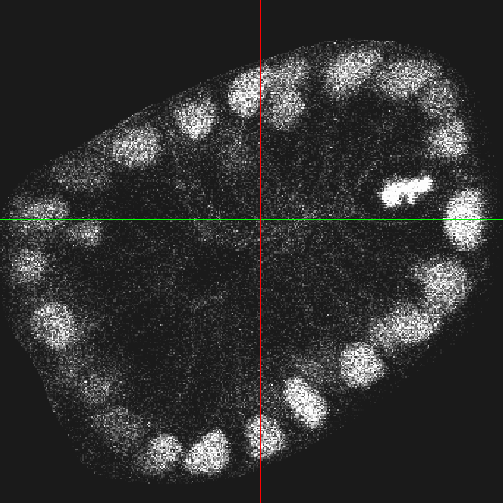
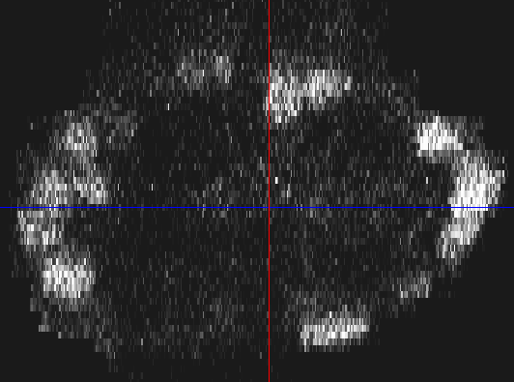
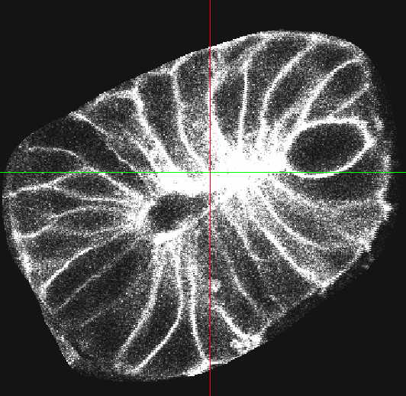
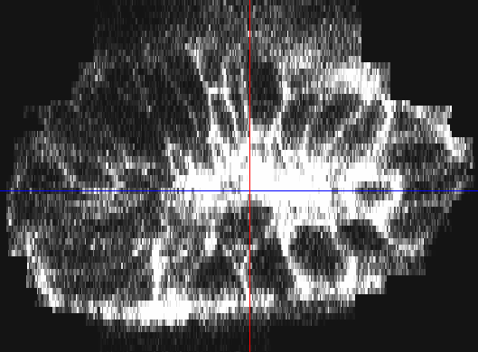
Evaluation
Real dataset :

Slide 22
Evaluation
On simulation Data :
On real Data :
Algorithm | Data type | amount of | Results
 |  | nuclei | correct | outside | over-detected | success(%)
MLOG | Synthetic | 1000 | 1000 | 72 | 0 | 93.3
KA | Synthetic | 1000 | 182 | 1539 | 0 | 7.2
P | Synthetic | 1000 | 964 | 11 | 0 | 95.4
Algorithm | Data type | amount of | Results
 |  | nuclei | correct | outside | Over-detected | success(%)
MLOG | Real | 141 | 104 | 52 | 8 | 51.7
KA | Real | 141 | 71 | 56 | 37 | 30.3
P | Real | 141 | 85 | 30 | 3 | 48.9

Slide 23
Conclusion
Proposal:
We proposed a new algorithm, taking advantage of the membrane information.
We prove that this algorithm performs better than the existing algorithm on synthetic and real data.
Future:
There are several ways to improve our algorithm.
Automatic thresholds.
Context dependant fusion with other algorithms.
Better denoising and resampling methods.
Use the detection of cell nuclei for membrane segmentation.

Slide 24
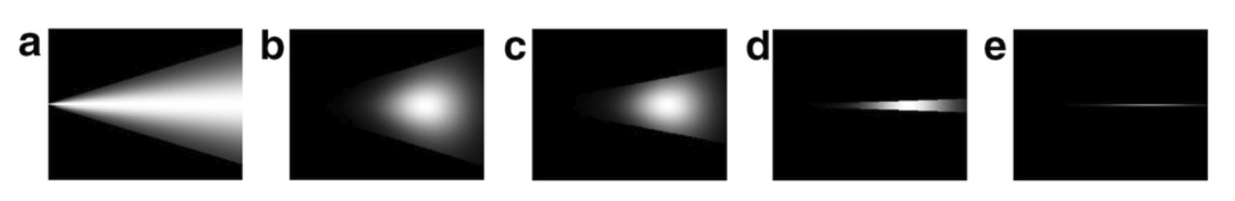
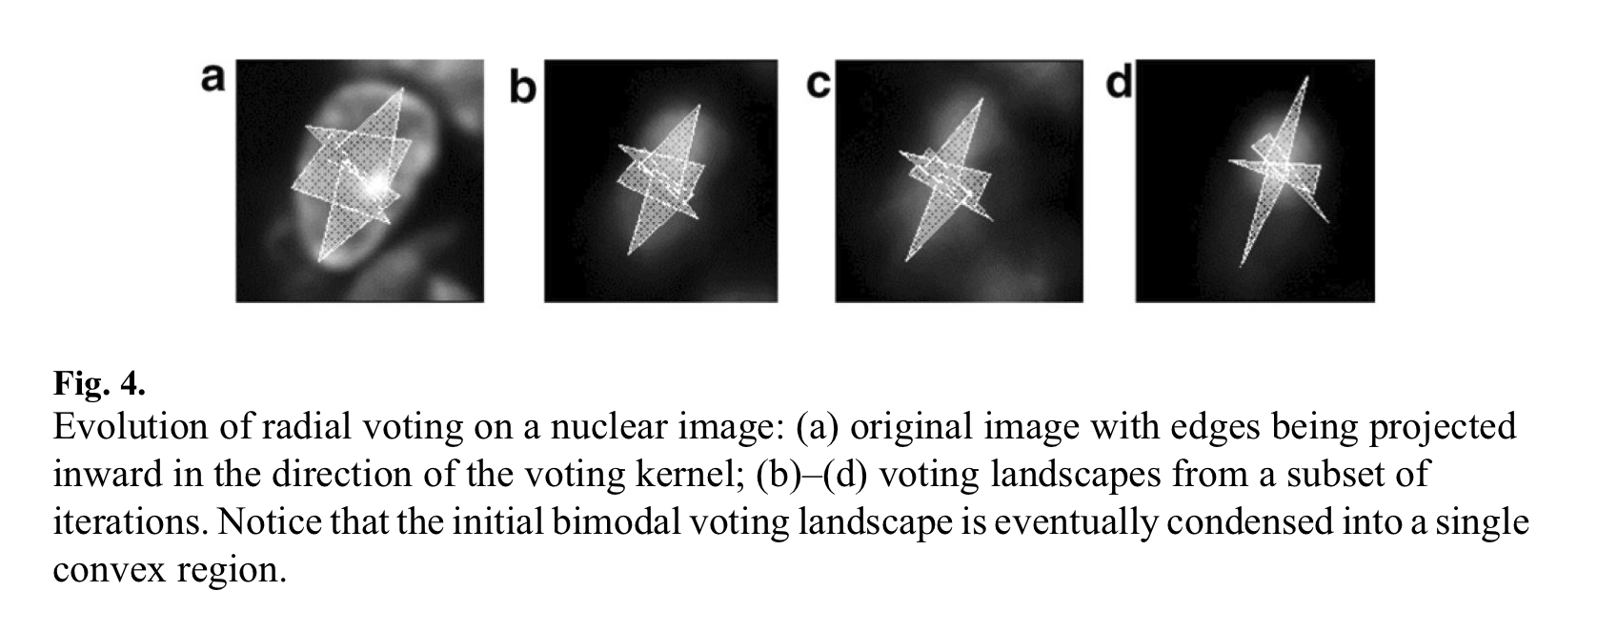
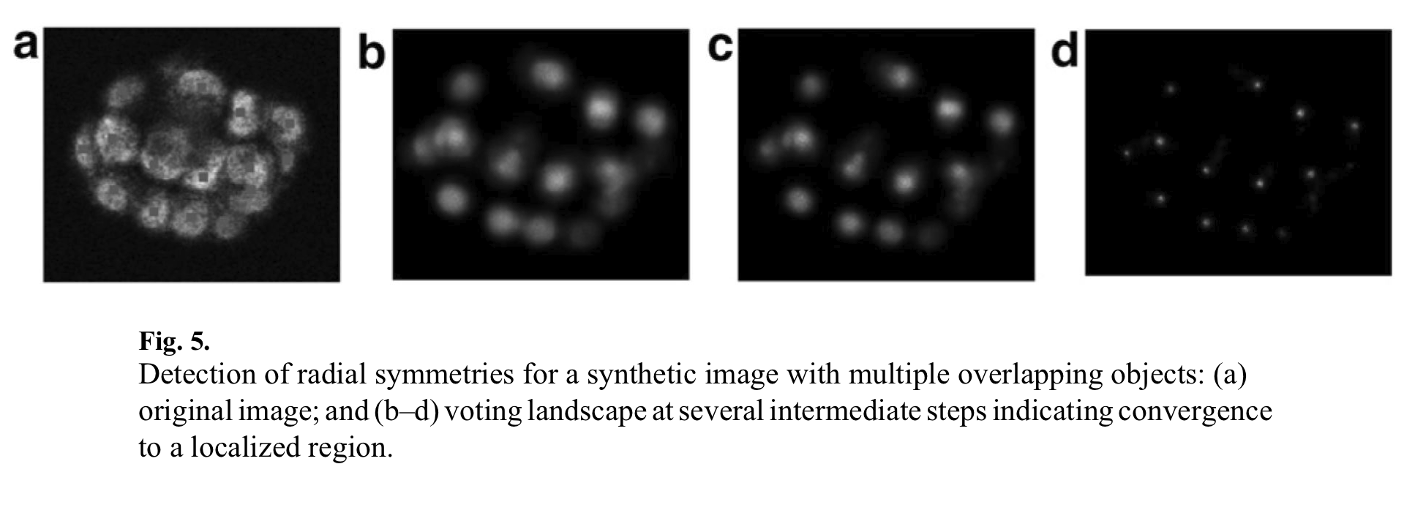
Radial Voting
Evolution of radial voting kernel.
Evolution of radial voting on a nuclei image.
Initial voting is condensed into a single convex voting region.

Slide 25
Use of nuclei information for membrane detection

Slide 26
Scale constrained Multiscale Laplacian of Gaussian

Slide 27
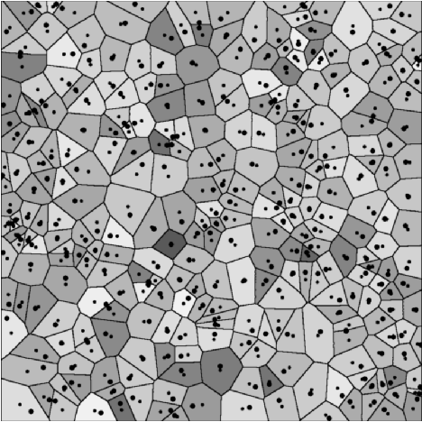
Radial Voting

